Slide 1
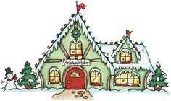
Santa’s Workshop
Click on the toy that goes into the correct letter box for Santa’s Elf to pack. Get all the packages ready for Santa and win the game!
Directions
Play the Game

Slide 2
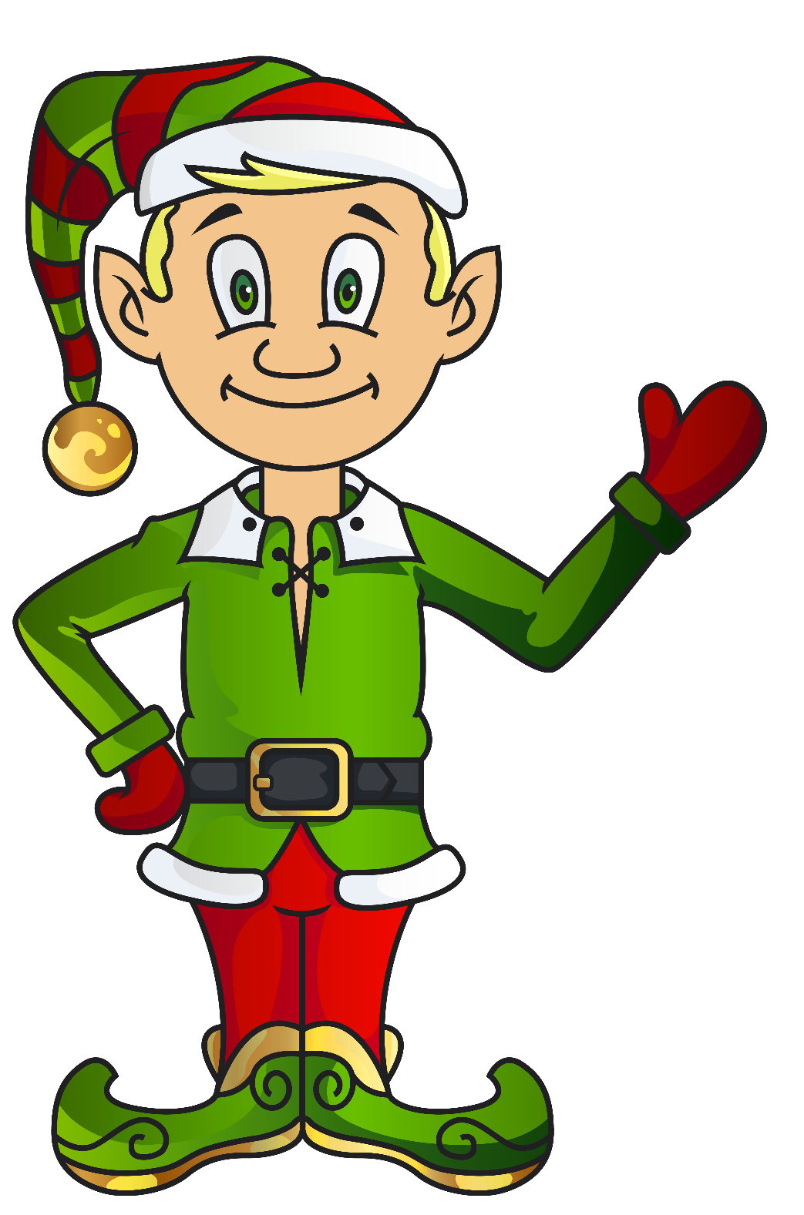
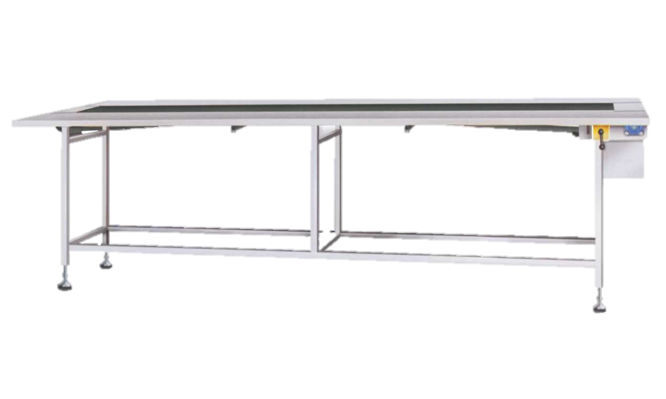
Hi, I’m Gus! Can you help me get the packages ready for Santa?
Help me load the correct presents into the boxes for Santa! Find the items that begin with the letter we are packing.

Slide 3
Click the lever. Which one begins with A?
A
Keep Going

Slide 4
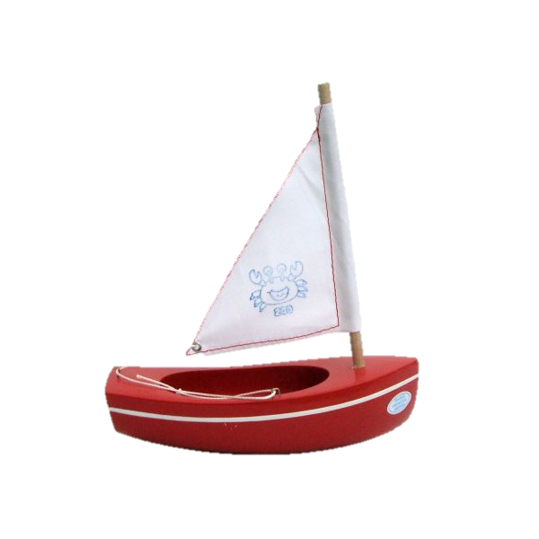
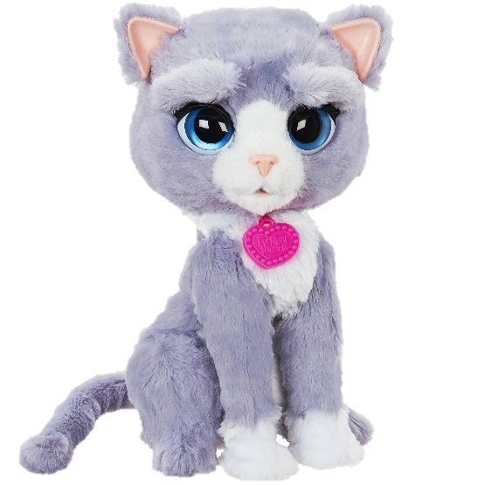
Click the lever. Which one begins with B?
B
Keep Going

Slide 5
Click the lever. Which one begins with C?
C
Keep Going

Slide 6
Click the lever. Which one begins with D?
D
Keep Going

Slide 7
Click the lever. Which one begins with E?
E
Keep Going

Slide 8
Click the lever. Which one begins with F?
F
Keep Going

Slide 9
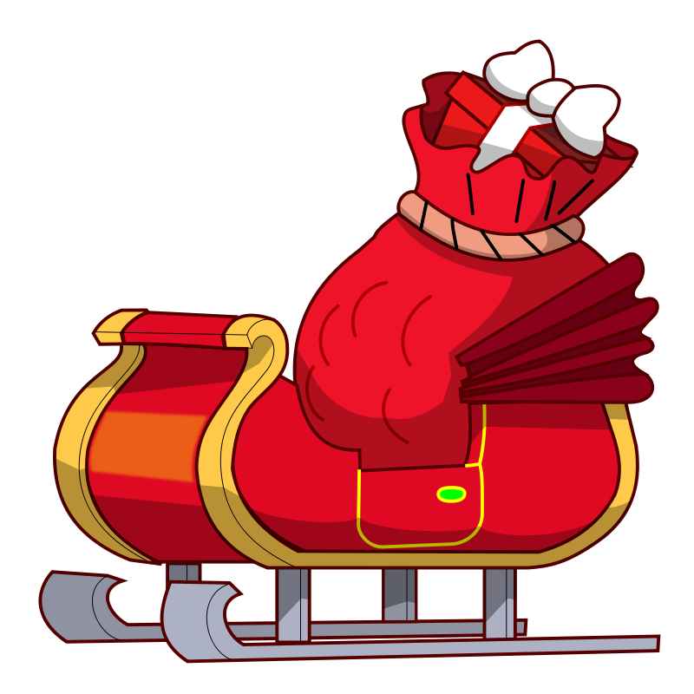
D
E
C
B
Time to load the sled!
A

